Slide 1
Basic Statistics 2

Slide 2
What Is a Z-Score?
A Z-score is a numerical measurement used in statistics of a value's relationship to the mean (average) of a group of values, measured in terms of standard deviations from the mean.
If a Z-score is 0, it indicates that the data point's score is identical to the mean score. A Z-score of 1.0 would indicate a value that is one standard deviation from the mean.
Z-scores may be positive or negative, with a positive value indicating the score is above the mean and a negative score indicating it is below the mean.

Slide 3
The Difference Between Z-Scores and Standard Deviation
Standard deviation is essentially a reflection of the amount of variability within a given data set.
What is Variability?
Variability is the extent to which data points in a statistical distribution or data set diverge from the average value as well as the extent to which these data points differ from each other.
standard deviation is a statistic that measures the dispersion of a dataset relative to its mean
The Z-score, by contrast, is the number of standard deviations a given data point lies from the mean.
For data points that are below the mean, the Z-score is negative. In most large data sets, 99% of values have a Z-score between -3 and 3, meaning they lie within three standard deviations above and below the mean.

Slide 4

z-score
A z-score, in simple terms, is a score that expresses the value of a distribution in standard deviation with respect to the mean. Let's take a look at the following formula that calculates the z-score:
Notes:
Here, X is the value in the distribution, µ is the mean of the distribution, and σ is the standard deviation of the distribution

Slide 5
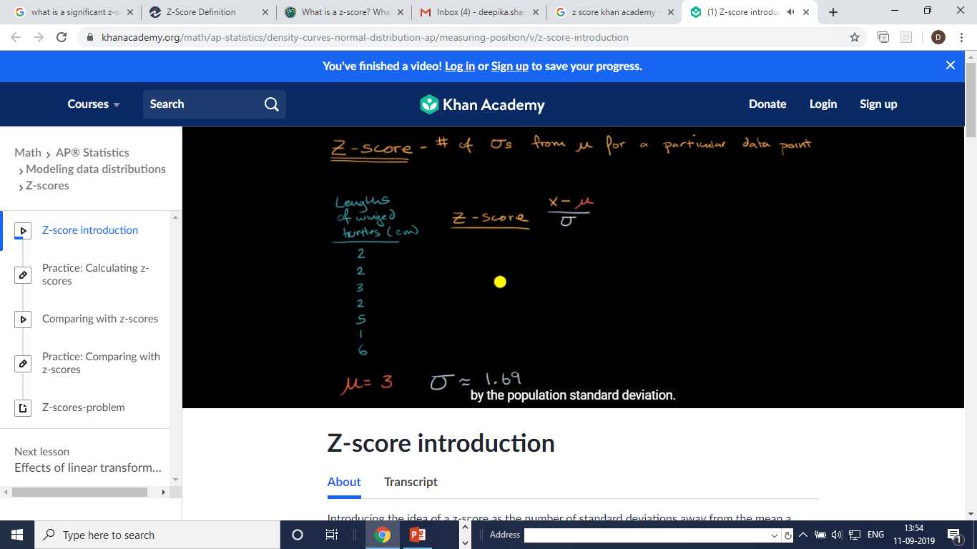
Calculating z score of each point

Slide 6
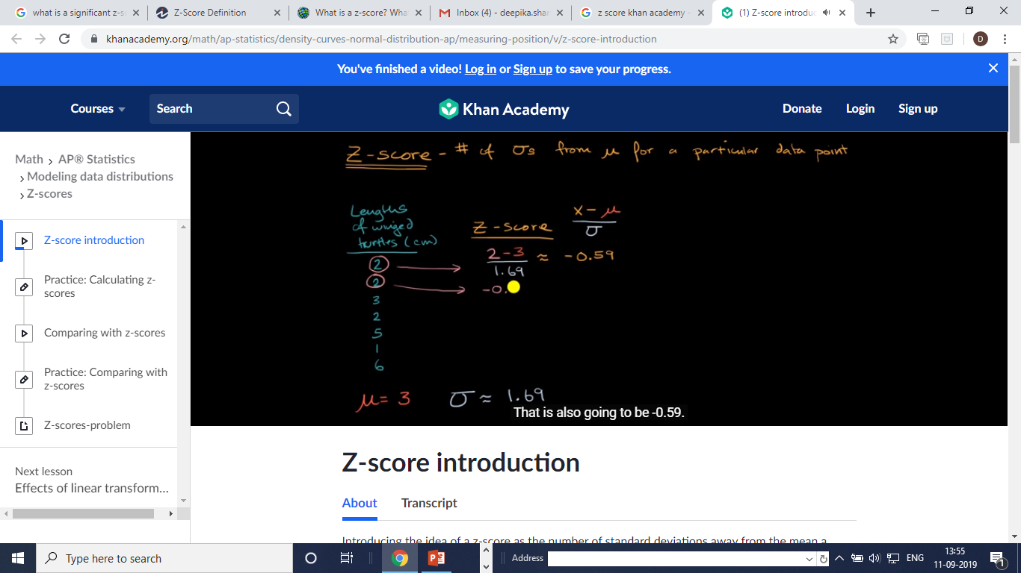

Slide 7
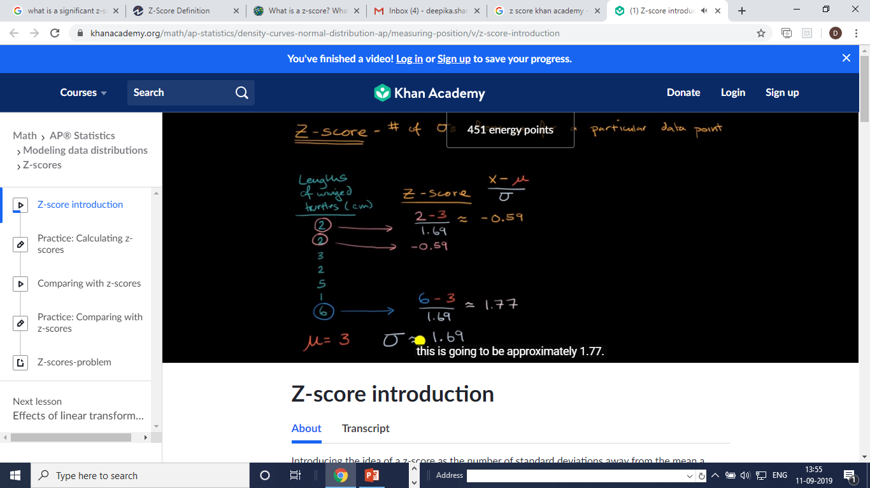

Slide 8
All the z score is above 1 and below 2 in all above ,mean.

Slide 9
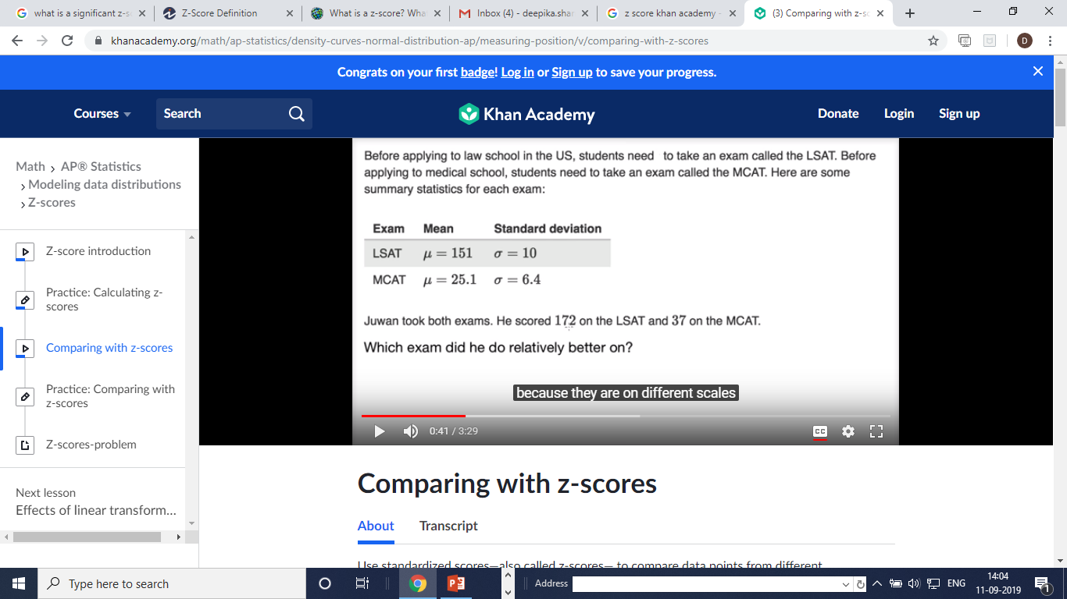

Slide 10
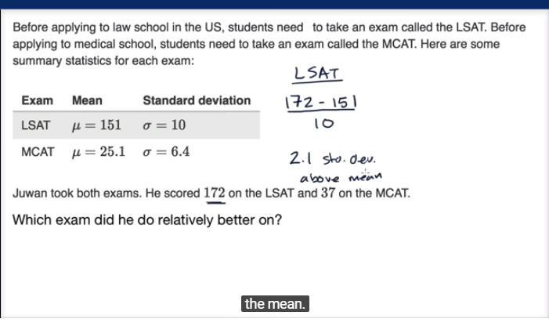
LCAT z score

Slide 11
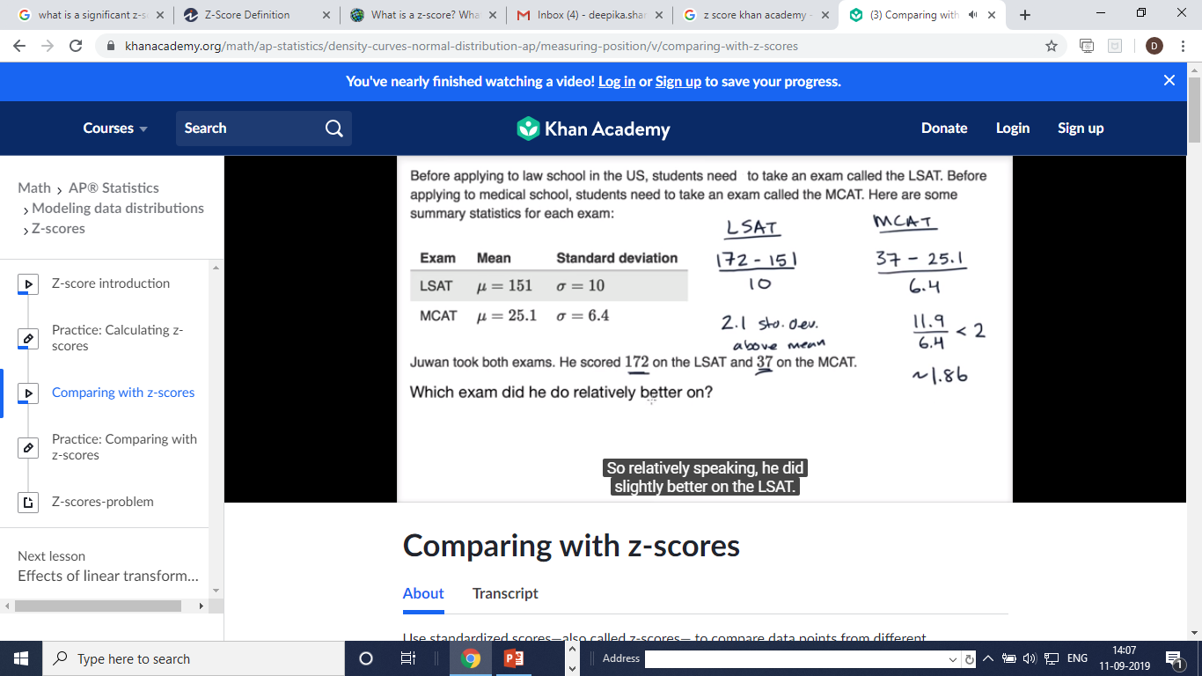
MCAT Z score

Slide 12
Relatively scoring better from two exams
We can say the student did relatively well in LSAT where he achieved 2.1
above the mean.

Slide 13
Let's understand this concept with an example where the null hypothesis is that it is common for students to score 68 marks in mathematics.
Let's define the significance level at 5%. If the p-value is less than 5%, then the null hypothesis is rejected and it is not common to score 68 marks in mathematics.
Let's get the z-score of 68 marks:
>>> zscore = ( 68 - classscore.mean() ) / classscore.std()
>>> zscore
2.283

Slide 14
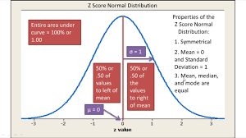

Slide 15
Central limit theoram
The central limit theorem states that the distribution of sample means approximates a normal distribution as the sample size gets larger (assuming that all samples are identical in size), regardless of population distribution shape.
CLT is a statistical theory that states that given a sufficiently large sample size from a population with a finite level of variance, the mean of all samples from the same population will be approximately equal to the mean of the population.
all the samples will follow an approximate normal distribution pattern, with all variances being approximately equal to the variance of the population divided by each sample's size.

Slide 16
Hypothesis Testing
An objective method of making decisions or inferences from sample data (evidence)

Slide 17

Hypothesis testing
Sample data used to choose between two choices i.e. hypotheses or statements about a population
We typically do this by comparing what we have observed to what we expected if one of the statements (Null Hypothesis) was true
Notes:
The cat is faced with a decision! To go out into the snow or not since it looks cold and wet. It has two hypotheses; Null: it won’t get its paws wet and be cold, Alternative: It will get its paws wet and will be cold. It could base it’s decision on data it collected in its mind in the past; when it went out in the snow in the past it’s paws did get cold and wet and so may make the decision not to go out based on that evidence! Hypothesis testing pervades all of our lives all of the time without us realising it. We make decisions based on evidence. Sometimes they are the right ones and sometimes they are wrong. There is a chance of getting it wrong, so we develop strategies for minimising these risks of getting it wrong – this is the basics of the framework for hypothesis testing!

Slide 18
Hypothesis testing Framework
Always two hypotheses:
H_{A}: Research (Alternative) Hypothesis
What we aim to gather evidence of
Typically that there is a difference/effect/relationship etc.
H₀: Null Hypothesis
What we assume is true to begin with
Typically that there is no difference/effect/relationship etc.
Notes:
This is what the text books say but to many students this language can be very inaccessible!
18

Slide 19

Could try explaining things in the context of “The Court Case”?
Members of a jury have to decide whether person
is guilty or innocent based on evidence
Null: The person is innocent
Alternative: The person is not innocent (i.e. guilty)
The null can only be rejected if there is enough evidence to doubt it
i.e. the jury can only convict if there is beyond reasonable doubt for the null of innocence
They do not know whether the person is really guilty or innocent so they may make a mistake
Notes:
Ask what decisions are being made here and what errors could be made.

Slide 20
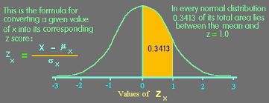
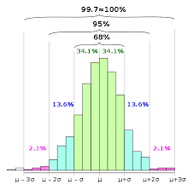
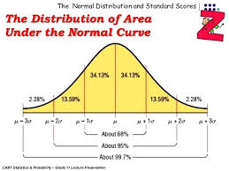
Area under the normal distribution

Slide 21
Types of Errors
Controlled via sample size (=1-Power of test)
Typically restrict to a 5% Risk
= level of significance
 | Study reports NO difference (Do not reject H₀) | Study reports IS a difference (Reject H₀)
H₀ is true Difference Does NOT exist in population
H_{A} is true Difference DOES exist in population
X
Type I Error
X
Type II Error
Prob of this = Power of test
Notes:
Before revealing all of this slide you could ask a few of the following questions:
What is the level of significance?
What is a Type I error? A Type II error?
What is a false positive?
What is statistical power?
You could you also ask how they would explain all of these things to a student?

Slide 22
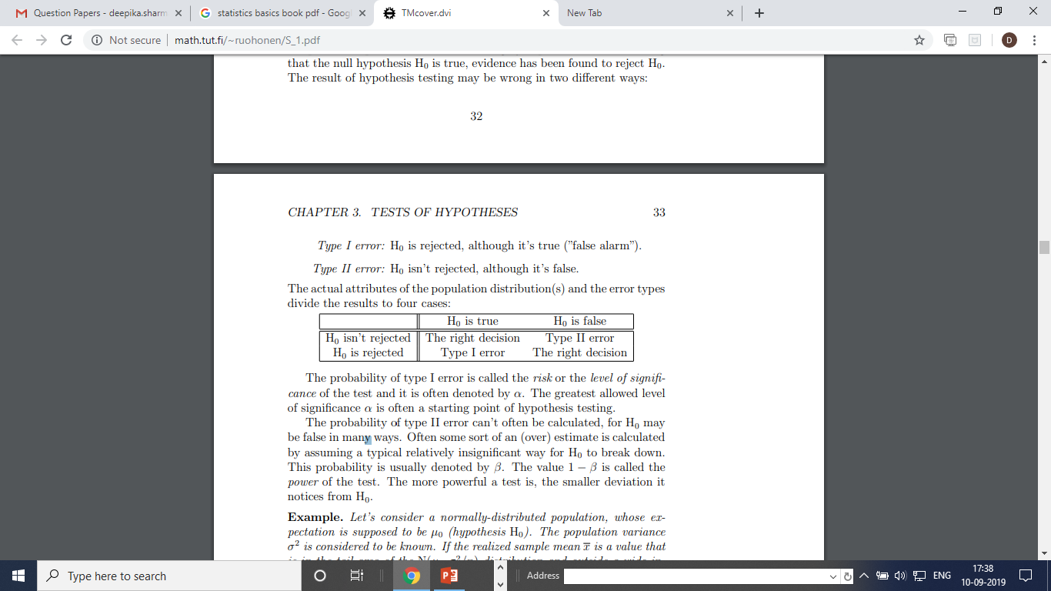
TESTS OF HYPOTHESES
Type I error: H0 is rejected, although it’s true (”false alarm”).
Type II error: H0 isn’t rejected, although it’s false.

Slide 23
Steps to undertaking a Hypothesis test
Define study question
Choose a suitable test
Set null and alternative hypothesis
Calculate a test statistic
Calculate a p-value
Make a decision and interpret your conclusions
Notes:
Point is to highlight the steps involved in undertaking a hypothesis test, but that the initial steps are often iterative when determining the research question(s) and the appropriate hypotheses and statistical tests to answer those questions.

Slide 24
Hypothesis Testing: Decision Rule
A statistical hypothesis test may return a value called p or the p-value. This is a quantity that we can use to interpret or quantify the result of the test and either reject or fail to reject the null hypothesis. This is done by comparing the p-value to a threshold value chosen beforehand called the significance level.
The significance level is often referred to by the Greek lower case letter alpha.
A common value used for alpha is 5% or 0.05. A smaller alpha value suggests a more robust interpretation of the null hypothesis, such as 1% or 0.1%.

Slide 25
A p-value
We can use statistical software to undertake a hypothesis test
One part of the output is the p-value (P)
If P < 0.05 reject H₀ => Evidence of H_{A} being true (i.e. IS association)
If P > 0.05 do not reject H₀ (i.e. NO association)
Notes:
What if p = 0.049 or 0.051? Discuss the fact that hypothesis testing involves weight of evidence and “shades of grey” rather than being a clear cut decision making process.

Slide 26
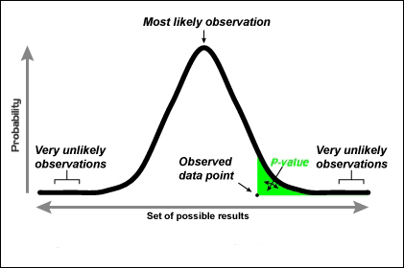
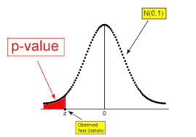
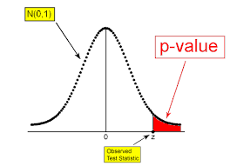
P-value
A p-value is the probability of rejecting a null-hypothesis when the hypothesis is proven true. The null hypothesis is a statement that says that there is no difference between two measures. If the hypothesis is that people who clock in 4 hours of study everyday score more that 90 marks out of 100. The null hypothesis here would be that there is no relation between the number of hours clocked in and the marks scored.

Slide 27
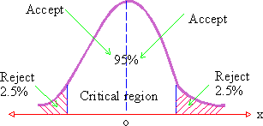
Confidence level =1-Significance level where 1-.05= .95 i.e. 95% (Accept)

Slide 28
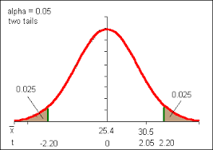
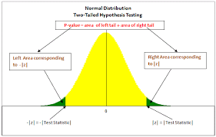
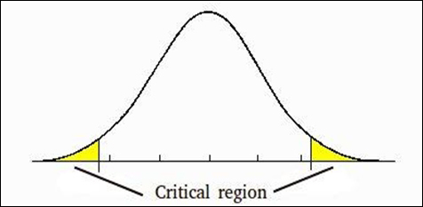
One-tailed and two-tailed tests
In a two-tailed test, both the tails of the null hypothesis are used to test the hypothesis.

Slide 29
In a two-tailed test, when a significance level of 5% is used, then it is distributed equally in the both directions, that is, 2.5% of it in one direction and 2.5% in the other direction.

Slide 30
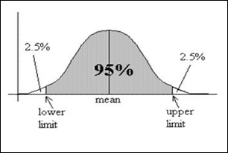
Confidence level
The significance level can be inverted by subtracting it from 1 to give a confidence level of the hypothesis given the observed sample data.
confidence level = 1 - significance level

Slide 31
Hypothesis Tests
ChiSquare test
Student T test
Paired T-Test
Pearson Correlation test
Spearman correlation test

Slide 32
Chi Square Test
The Chi-Square test of independence is a statistical test to determine if there is a significant relationship between 2 categorical variables.
In simple words, the Chi-Square statistic will test whether there is a significant difference in the observed vs the expected frequencies of both variables.

Slide 33

The Chi-Square statistic is calculated as follows:

Slide 34
The Null hypothesis is that there is NO association between both variables.
The Alternate hypothesis says there is evidence to suggest there is an association between the two variables.
In our case, we will use the Chi-Square test to find which variables have an association with the Survived variable. If we reject the null hypothesis, it's an important variable to use in your model.
To reject the null hypothesis, the calculated P-Value needs to be below a defined threshold. Say, if we use an alpha of .05, if the p-value < 0.05 we reject the null hypothesis. If that’s the case, you should consider using the variable in your model.

Slide 35
Rules to use the Chi-Square Test:
1. Variables are Categorical
2. Frequency is at least 5
3. Variables are sampled independently
Chi-Square Test in Python
We will now be implementing this test in an easy to use python class we will call ChiSquare. Our class initialization requires a panda’s data frame which will contain the dataset to be used for testing. The Chi-Square test provides important variables such as the P-Value mentioned previously, the Chi-Square statistic and the degrees of freedom.
from scipy.stats import chi2_contingency
from scipy.stats import chisquare

Slide 36
Parametric Statistical Significance Tests
Parametric statistical tests assume that a data sample was drawn from a specific population distribution.
They often refer to statistical tests that assume the Gaussian distribution. Because it is so common for data to fit this distribution, parametric statistical methods are more commonly used.
In general, each test calculates a test statistic that must be interpreted with some background in statistics and a deeper knowledge of the statistical test itself. Tests also return a p-value that can be used to interpret the result of the test. The p-value can be thought of as the probability of observing the two data samples given the base assumption (null hypothesis) that the two samples were drawn from a population with the same distribution.

Slide 37
The p-value can be interpreted in the context of a chosen significance level called alpha. A common value for alpha is 5%, or 0.05. If the p-value is below the significance level, then the test says there is enough evidence to reject the null hypothesis and that the samples were likely drawn from populations with differing distributions.
p <= alpha: reject null hypothesis, different distribution.
p > alpha: fail to reject null hypothesis, same distribution.

Slide 38
Student’s t-Test
The Student’s t-test is a statistical hypothesis test that two independent data samples known to have a Gaussian distribution, have the same Gaussian distribution,
The assumption or null hypothesis of the test is that the means of two populations are equal. A rejection of this hypothesis indicates that there is sufficient evidence that the means of the populations are different, and in turn that the distributions are not equal.
Fail to Reject H0: Sample distributions are equal.
Reject H0: Sample distributions are not equal.
The Student’s t-test is available in Python via the ttest_ind() SciPy function. The function takes two data samples as arguments and returns the calculated statistic and p-value.
stat, p = ttest_ind(data1, data2)

Slide 39
Paired Student’s t-Test
We may wish to compare the means between two data samples that are related in some way
The default assumption, or null hypothesis of the test, is that there is no difference in the means between the samples. The rejection of the null hypothesis indicates that there is enough evidence that the sample means are different.
Fail to Reject H0: Paired sample distributions are equal.
Reject H0: Paired sample distributions are not equal.
The paired Student’s t-test can be implemented in Python using the ttest_rel() SciPy function.
stat, p = ttest_rel(data1, data2)

Slide 40
Measures of Relationship
Covariance: Covariance is a measure of the relationship between the variability of 2 variables i.e It measures the degree of change in the variables, when one variable changes, will there be the same/a similar change in the other variable.

Slide 41
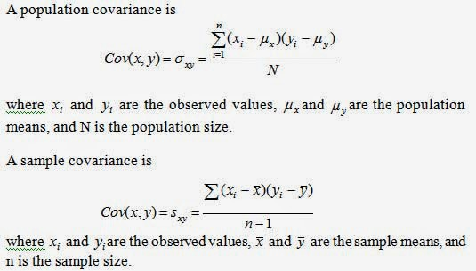
Covariance

Slide 42
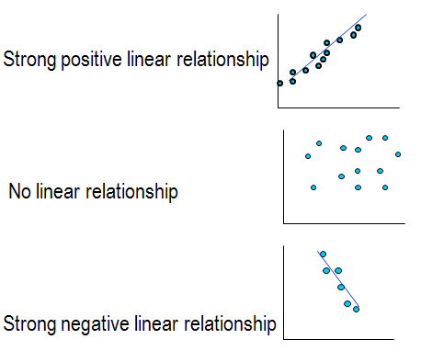
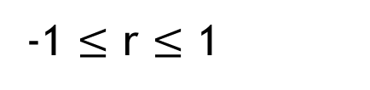
Correlation Coefficient r
Measures strength of a relationship between two continuous variables
-1 $≤$ r $≤$ 1
r = 0.9
r = 0.01
r = -0.9
Notes:
Correlation quantifies this relationship. Correlation coefficients range from -1 and +1 with 0 meaning there is no relationship at all (see middle graph). The further away from 0 the coefficient is, the stronger the relationship. A positive number means that as x increases, so does y and negative coefficients that y decreases as x increases.
Here are some examples. The first shows strong positive correlation, the second no relationship and the 3rd a strong negative relationship.

Slide 43
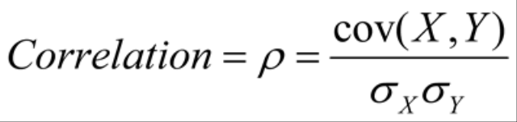
Correlation
Correlation: Correlation gives a better understanding of covariance. It is normalized covariance. Correlation tells us how correlated the variables are to each other. It is also called as Pearson Correlation Coefficient.

Slide 44
The value of correlation ranges from -1 to 1. -1 indicates negative correlation i.e with an increase in 1 variable independent there is a decrease in the other dependent variable.1 indicates positive correlation i.e with an increase in 1 variable independent there is an increase in the other dependent variable.0 indicates that the variables are independent of each other.

Slide 45
Correlation Interpretation
An interpretation of the size of the coefficient has been described by Cohen (1992) as:
Cohen, L. (1992). Power Primer. Psychological Bulletin, 112(1) 155-159
Correlation coefficient value | Relationship
-0.3 to +0.3 | Weak
-0.5 to -0.3 or 0.3 to 0.5 | Moderate
-0.9 to -0.5 or 0.5 to 0.9 | Strong
-1.0 to -0.9 or 0.9 to 1.0 | Very strong
Notes:
Students often need to interpret the coefficient and like to have guidelines for deciding on the strength of the relationship. There are alternative guidelines available but we use Cohen’s to interpret as weak, moderate and strong relationships.

Slide 46
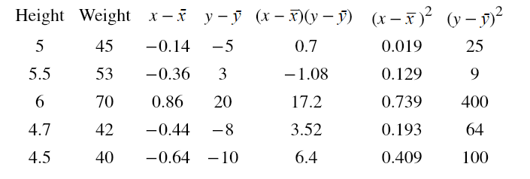
Calculating correlation

Slide 47
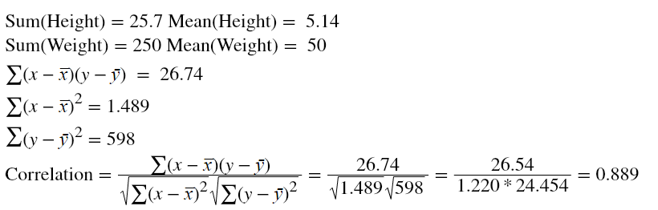

Slide 48
Correlation 0.889 tells us Height and Weight has a positive correlation. It is obvious that as the height of a person increases weight too increases.
cov(X, Y) = (sum (x - mean(X)) * (y - mean(Y)) ) * 1/(n-1)
# calculate covariance matrix
covariance = cov(data1, data2)
print(covariance)
Pearson’s Correlation
Pearson's correlation coefficient = covariance(X, Y) / (stdv(X) * stdv(Y))
from scipy.stats import pearsonr
from scipy.stats import spearmanr

Slide 49
ANOVA Test
Analysis of variance (ANOVA) uses F-tests to statistically assess the equality of means when you have three or more groups.
The term F-test is based on the fact that these tests use the F-statistic to test the hypotheses.
An F-statistic is the ratio of two variances and it was named after Sir Ronald Fisher.
Variances measure the dispersal of the data points around the mean. Higher variances occur when the individual data points tend to fall further from the mean
https://statisticsbyjim.com/hypothesis-testing/t-tests-t-values-t-distributions-probabilities/
https://statisticsbyjim.com/anova/f-tests-anova/

Slide 50

F Test – (Fisher test)- In One Way ANOVA
An F-statistic is the ratio of two variances, or technically, two mean squares. Mean squares are simply variances that account for the degrees of freedom (DF) used to estimate the variance.
Variances are the sum of the squared deviations from the mean.

Slide 51
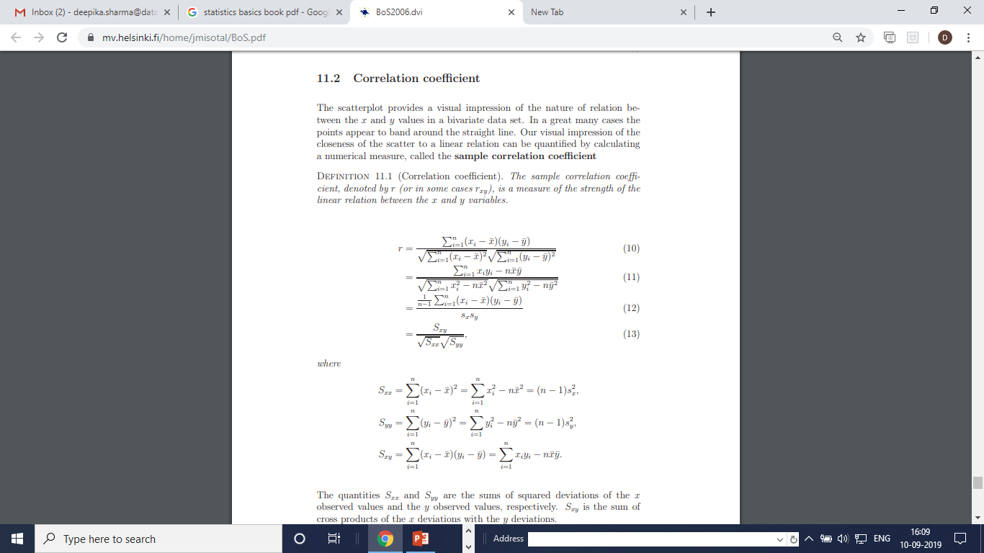

Slide 52
References
Khanacademy.com

